Slide 1
When it comes to car crashes, when do injuries occur? What about fatalities?
An Investigation by Nabil Darwich and Hamza Mughal
Using real crash data from the City of Chicago from the summer of 2017/2018

Slide 2
Finding a Good Dataset
Original Data: Montgomery County’s Traffic Violations https://data.montgomerycountymd.gov/Public-Safety/Traffic-Violations/4mse-ku6q
Violation info from all electronic traffic violations in Montgomery County
1m+ records
Significant Columns:
Geolocation
Time of stop
Accident (Y/N)
Belts (Y/N)
Personal Injury (Y/N)
Fatal (Y/N)
Alcohol (Y/N)
Driver race/gender/city/state
Vehicle make/model/year/type

Slide 3
Why We Switched
Many Inconsistencies, lack of good management/validation
The Accident Column never had a YES, even when fatalities occurred
Drivers were charged with DUI/DWI, but the Alcohol column indicated NO
Seatbelt violations when Seatbelt column indicated a seatbelt was worn
Overall improperly recorded data
No data on vehicle passengers/pedestrians involved in the crash
Lack of a standard format
Violation info was sometimes entered by a human
Descriptions sometimes included spelling errors
Too many non-accidents, useless for our problem statement
Not enough relevant columns to build a good model

Slide 4
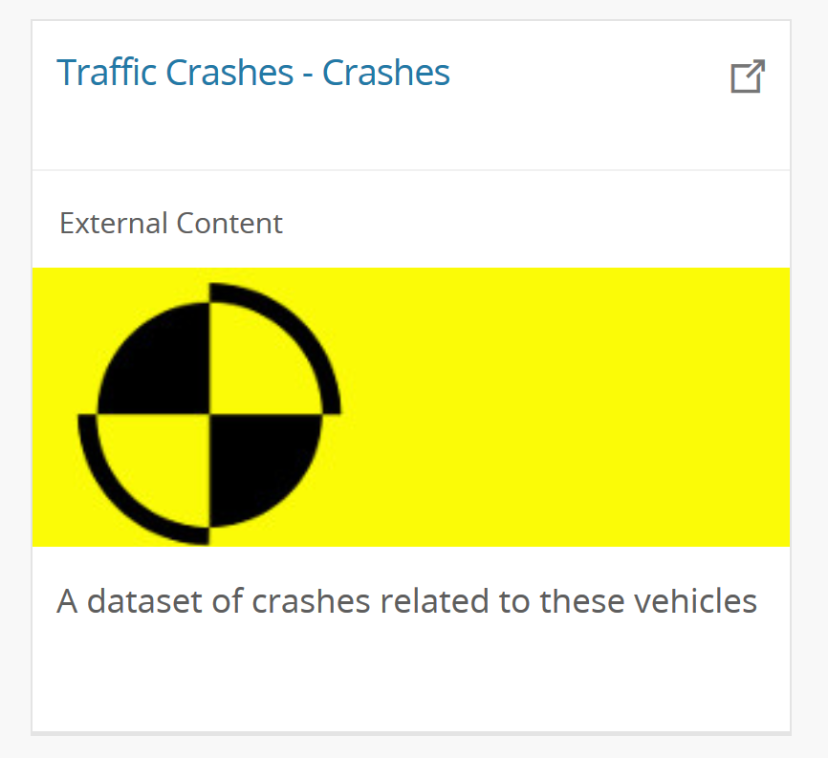
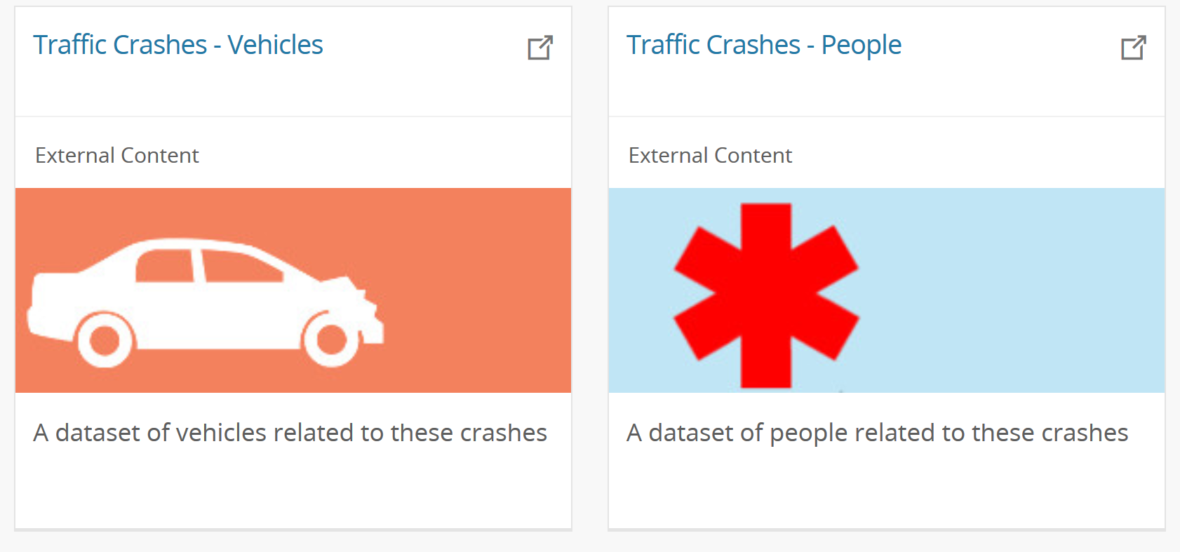
New Data: Traffic Crashes from the City of Chicago
Not only one dataset, but 3
Dataset about the crash
RD_NO, DATE, ROAD_DEFECT, TYPE, WEATHER. LIGHTING, PRIM_CAUSE, …

Slide 5
New Data: Traffic Crashes from the City of Chicago
Not only one dataset, but 3
Dataset about the crash
RD_NO, DATE, ROAD_DEFECT, TYPE, WEATHER. LIGHTING, PRIM_CAUSE, …
Dataset about the vehicles involved
RD_NO, NUM_PASSENGERS, MAKE, MODEL, EXCEED_SPEED_LIMIT, …

Slide 6
New Data: Traffic Crashes from the City of Chicago
Not only one dataset, but 3
Dataset about the crash
RD_NO, DATE, ROAD_DEFECT, TYPE, WEATHER. LIGHTING, PRIM_CAUSE, …
Dataset about the vehicles involved
RD_NO, NUM_PASSENGERS, MAKE, MODEL, EXCEED_SPEED_LIMIT, …
Dataset about the individuals involved
RD_NO, SEX, AGE, PERSON_TYPE (DRIVER/PASSENGER/PED), BAC_RESULT, …

Slide 7
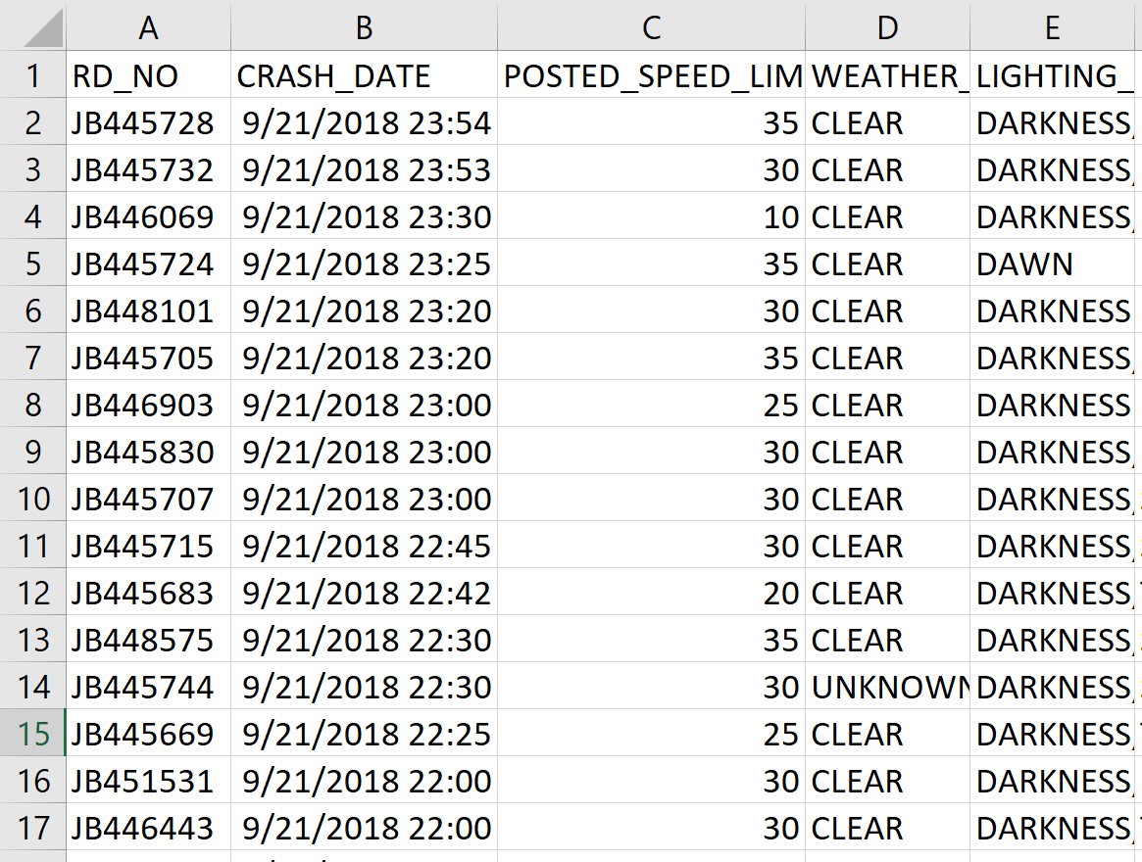
Traffic Crashes – City of Chicago
200k+ records
Consistent
Uniform
Standardized
Informative

Slide 8
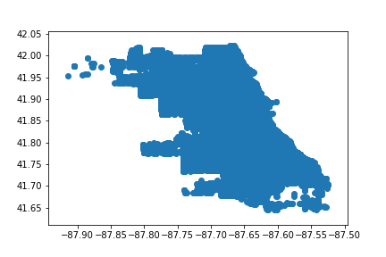
Traffic Crashes - Visualization
Plot crash geolocations on graph

Slide 9
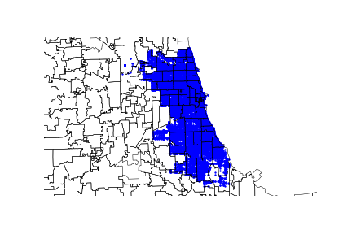
Traffic Crashes - Visualization
Plot crash geolocations on graph
Not very meaningful, plot against a map…
More details! Southeast Chicago seemed to be free from crashes, why?

Slide 10
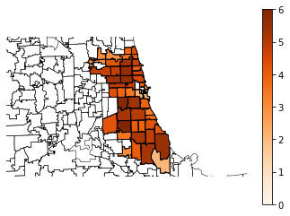
Traffic Crashes - Visualization
Plot crash geolocations on graph
Not very meaningful, plot against a map
More details, Southeast Chicago seemed to be free from crashes
Plot Chicago population density data

Slide 11
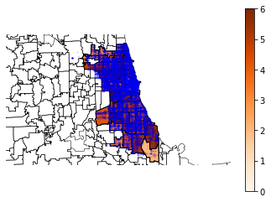
Traffic Crashes - Visualization
Plot crash geolocations on graph
Not very meaningful, plot against a map
More details, Southeast Chicago seemed to be free from crashes
Plot Chicago population density data
Plot crashes with population densities

Slide 12
Traffic Crashes - Preprocessing
Crashes dataset was 200k+ crash entries, 48 features
From 2014 to today
Also had two other datasets
Vehicles involved (450k+ entries, 71 features)
People involved (500k+ entries, 29 features)
Challenges Faced:
Scaling down the data for a feasible project
Combining Crash/People/Vehicle datasets
Making the data interpretable by an algorithm
Handling empty entries
Reducing the number of features

Slide 13
Traffic Crashes – Preprocessing Challenges
Scaling down the data for a feasible project
Combining Crash/People/Vehicle datasets
Making the data interpretable by an algorithm
Handling empty entries
Reducing the number of features

Slide 14
Traffic Crashes – Preprocessing Scaling down the data
Vehicle data was
Very sparse
Hard to discretize w/o vehicle database
Different years meant
Different road systems, road conditions, laws
Different safety standards
Different seasons meant
Different weather conditions
Different common reasons for crashes
Different severity levels for crashes

Slide 15
Traffic Crashes – Preprocessing Scaling down the data
Vehicle data was
Very sparse
Hard to discretize w/o vehicle database
Different years meant
Different road systems, road condition, laws
Different safety standards
Different seasons meant
Different weather conditions
Different common reasons for crashes
Different severity levels for crashes
Solution: High level decision of only using Crashes & People datasets from summer 2018 as training (30k crash entries, 67k people entries)

Slide 16
Traffic Crashes – Preprocessing Challenges
Scaling down the data for a feasible project
Combining Crash/People datasets
Making the data interpretable by an algorithm
Handling empty entries
Reducing the number of features

Slide 17
Traffic Crashes – Preprocessing Combining crashes/people
Both crashes and people included the report number (RD_NO) column
Can be used as unifier
Multiple people can be involved in a single crash
RD_NO showed up multiple times in People table

Slide 18
Traffic Crashes – Preprocessing Combining crashes/people
Both crashes and people included the report number (RD_NO) column
Can be used as unifier
Multiple people can be involved in a single crash
RD_NO showed up multiple times in People table
Solution: Join people on crashes
Use Excel formula to append crash information to every person that has the same RD_NO
This is similar to a left outer join from people on crashes, with the condition being RD_NO
New table entries: People merged with Crashes they were in

Slide 19
Traffic Crashes – Preprocessing Challenges
Scaling down the data for a feasible project
Combining Crash/People datasets
Making the data interpretable by an algorithm
Handling empty entries
Reducing the number of features

Slide 20
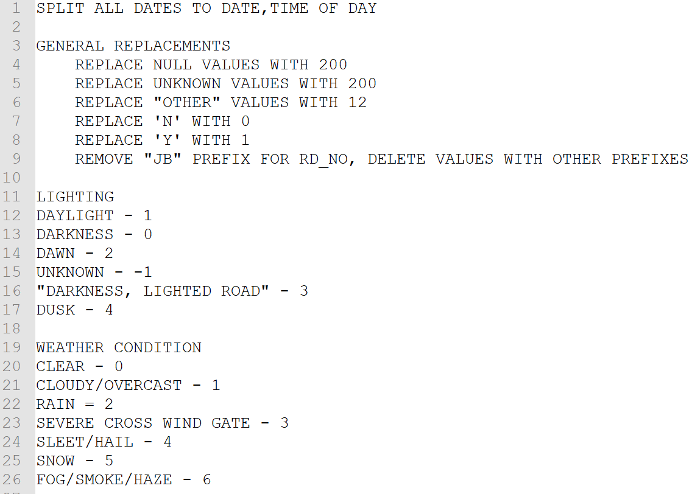
Traffic Crashes – Preprocessing Making the data interpretable
Crashes included many string descriptions
E.g: light, darkness, dusk, dawn
Some algorithms required decimal values
Many empty values existed

Slide 21
Traffic Crashes – Preprocessing Making the data interpretable
Crashes included many string descriptions
E.g: light, darkness, dusk, dawn
Some algorithms required decimal values
Many empty values existed
Solution: Discretize by binning (enumerate)
Record a mapping of what each bin meant
Group ages to age groups (child, young adult, …)
Assign number 200 to empty values
Reuse that number for the value “UNKNOWN”

Slide 22
Traffic Crashes – Preprocessing Challenges
Scaling down the data for a feasible project
Combining Crash/People datasets
Making the data interpretable by an algorithm
Handling empty entries
Reducing the number of features

Slide 23
Traffic Crashes – Preprocessing Feature Reduction
Many features were redundant/irrelevant/consequents
CRASH_DATE was repeated twice
Pedestrians/Bicyclists don’t have a VEHICLE_NO
Whether or not they were transported to an ER is a consequent

Slide 24
Traffic Crashes – Preprocessing Feature Reduction
Many features were redundant/irrelevant/consequents
CRASH_DATE was repeated twice
Pedestrians/Bicyclists don’t have a VEHICLE_NO
Whether or not they were transported to an ER is a consequent
Solution: Delete such columns, continue feature reduction when data mining

Slide 25
Traffic Crashes – Preprocessing Feature Reduction
Many features were redundant/irrelevant/consequents
CRASH_DATE was repeated twice
Pedestrians/Bicyclists don’t have a VEHICLE_NO
Whether or not they were transported to an ER is a consequent
Solution: Delete such columns, continue feature reduction when data mining
Project goal set: Determine the INJURY_CLASSIFICATION for anyone involved in a car crash
INJURY_CLASSIFICATION Domain:
0: NO INDICATION OF INJURY
1: REPORTED INJURY, NO EVIDENCE
2: NONINCAPACITATING INJURY
3: INCAPACITATING INJURY
4: FATAL

Slide 26
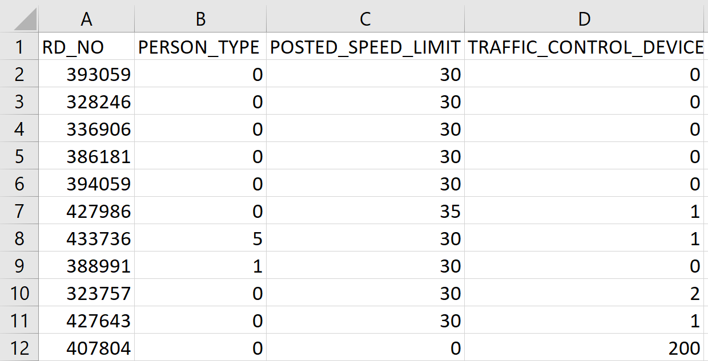
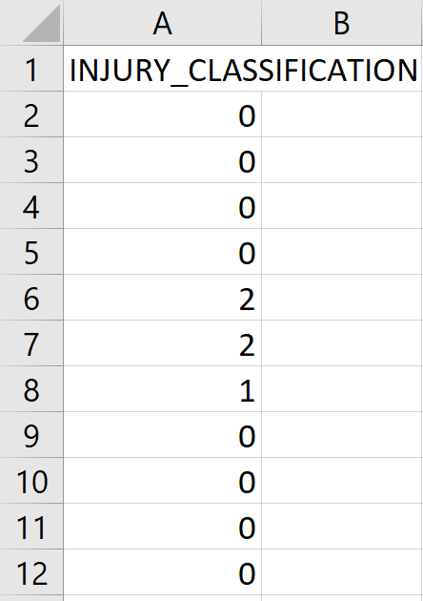
Traffic Crashes – Transformation

Slide 27
Traffic Crashes – Transformation Challenges
Still too many unimportant features
Data was very imbalanced, out of 67k people involved in crashes
61k had no indication of injuries (91%)
3.5k sustained non-incapacitating injuries (5%)
Only 36 were fatal (0.05%, it’s a good thing though ☺)
Different algorithms required different data types
Under/oversampling required integers
Association analysis with Apriori required strings

Slide 28
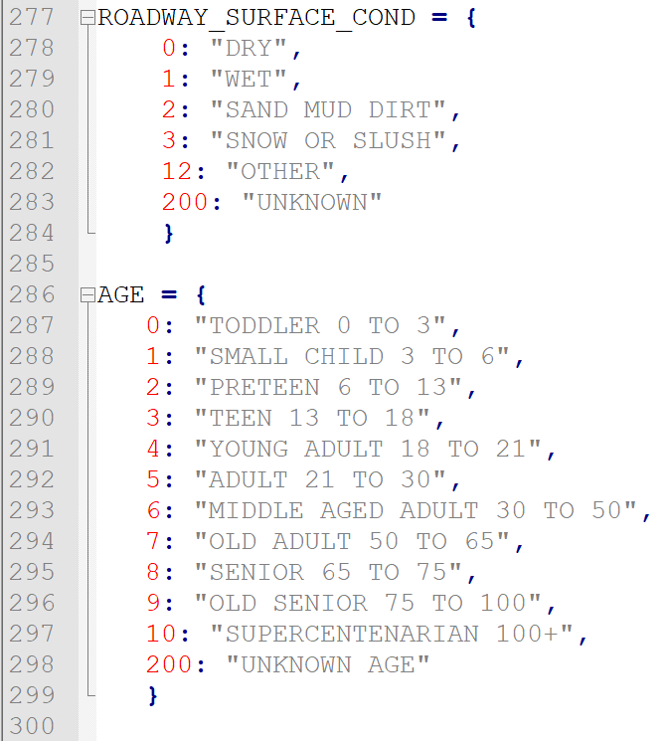
Traffic Crashes – Transformation Solutions
Select the 20 best features
Using SKLearn’s SelectKBest
Oversample the data to preserve information about NO INJURIES
Using imblearn’s RandomOverSampler
Translate the oversampled data back to the original strings
Using Python dictionaries
Final Training Data:
220k Entries
20 Features

Slide 29
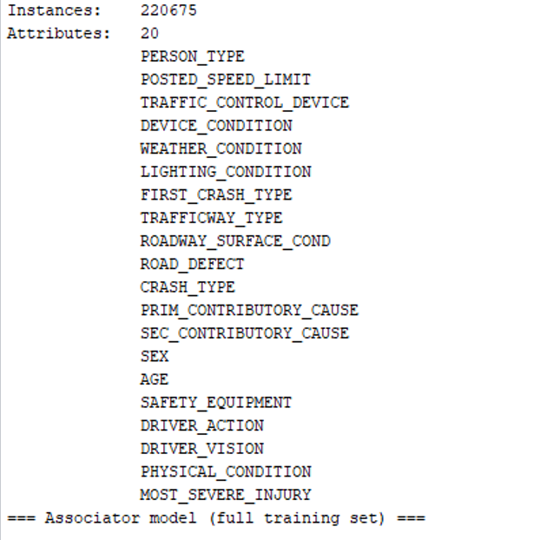
Traffic Crashes – Transformation Best 20 Features

Slide 30

Traffic Crashes – Data Mining
Weka

Slide 31
Traffic Crashes – Data Mining Association Analysis
Considering our problem statement we were curious as to see what interesting rules were generated to lead to fatalities
Achieved by using Weka
Initial data made it difficult to find interesting rules to our problem
Rules were found to be infrequent
Never showed up despite increasing number of rules to generate and the lower bound
Oversampling helped immensely
Consequent is INJURY_CLASSIFICATION
To have only one consequent, only confidence was WEKA’s output
Attempted classification with a 10 fold split on the oversampled training data

Slide 32
Traffic Crashes – Data Mining A few interesting rules found…
LIGHTING_CONDITION=DAYLIGHT FIRST_CRASH_TYPE=ANIMAL CRASH_TYPE=INJURY AND / OR TOW DUE TO CRASH 2 ==> INJURY_CLASSIFICATION=FATAL
0.33 confidence
Crashing into an animal indicates is likely to be fatal
TRAFFIC_CONTROL_DEVICE=NO_CONTROLS LIGHTING_CONDITION=DARKNESS LIGHTED ROAD ROAD_DEFECT=NO DEFECTS SEX=M ==> INJURY_CLASSIFICATION=FATAL
0.87 confidence
In a lighted non-defective road at night, males are likely to die in a crash
FIRST_CRASH_TYPE=FIXED OBJECT SEX=M DRIVER_VISION=UNKNOWN ==> INJURY_CLASSIFICATION=FATAL
0.85 confidence
Crashing into a fixed object (e.g: tree) and being male means a likely death

Slide 33
Traffic Crashes – Data Mining Determining Classifiers
Our dataset already has labels and a decent number of features:
Naïve Bayes
High scalable
Pretty fast!
Decision Stump
One level decision tree
Random Tree (Decision tree)
Built on a random subset of columns
Random Forest
Different samples of data taken to grow multiple trees where all trees vote on what the output should be (the majority vote wins)

Slide 34
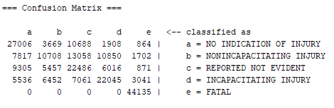
Traffic Crashes – Evaluation/Interpretation Results of Classification (Training)
Naïve Bayes
57.3% correct classified, 42.7% incorrectly classified
Precision = .557
Recall = .573
F Measure = .558
Overall not too terrible!

Slide 35
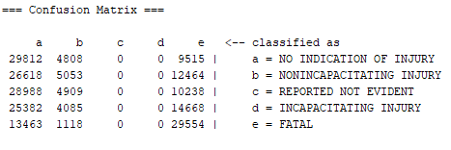
Traffic Crashes – Evaluation/Interpretation Results of Classification (Training)
Decision Stump
29.2% correct classified, 70.8% incorrectly classified
Recall = .292
Can be improved

Slide 36
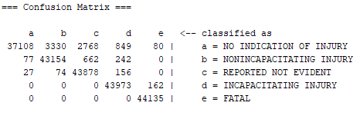
Traffic Crashes – Evaluation/Interpretation Results of Classification (Training)
Random Tree
96.2% correct classified, 3.8% incorrectly classified
Precision = .964
Recall = .962
F Measure = .961
Really good!

Slide 37
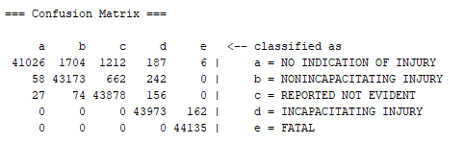
Traffic Crashes – Evaluation/Interpretation Results of Classification (Training)
Random Forest
98% correct classified, 2% incorrectly classified
Precision = . 980
Recall = .980
F Measure = .980
Excellent!

Slide 38
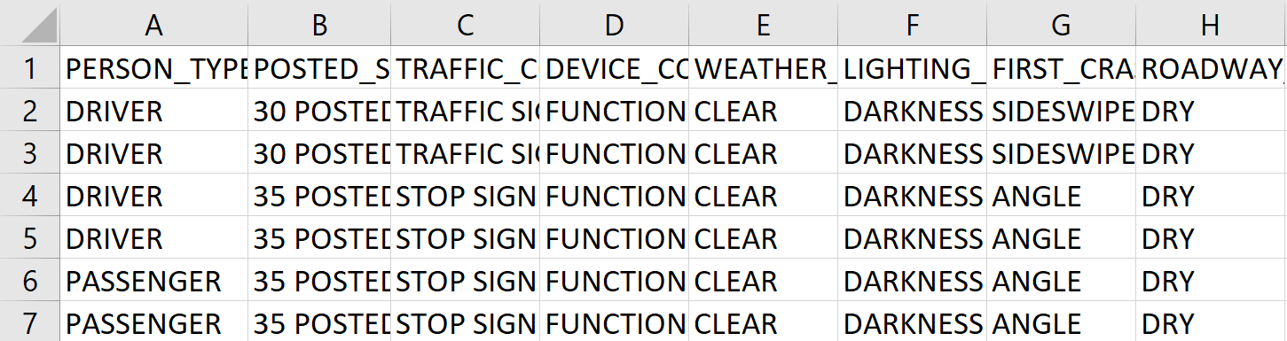
Traffic Crashes – Evaluation/Interpretation Next Steps
We now were ready for testing
Test data taken from Summer 2017
22k Crashes, 49k People
Followed same preprocessing steps, using the same mappings
Final Test Set: 49k People and their crashes, 20 features

Slide 39
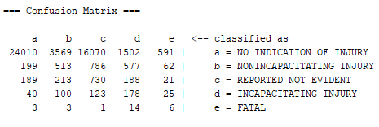
Naïve Bayes
51.1% correct classified, 48.9% incorrectly classified
Precision = .911
Recall = .512
F Measure = .640

Slide 40
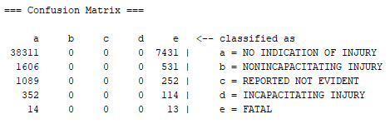
Decision Stump
77.1% correct classified, 22.9% incorrectly classified
Recall = .771

Slide 41
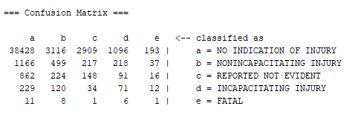
Random Tree
78.7% correct classified, 21.3% incorrectly classified
Precision = .876
Recall = .787
F Measure = .828

Slide 42
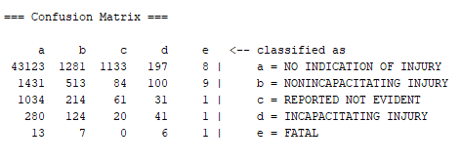
Random Forest
88% correct classified, 12% incorrectly classified
Precision = .877
Recall = .880
F Measure = .879

Slide 43
Interpretation
Nabil: Naïve Bayes (F-Score 0.64)

Slide 44
Interpretation
Hamza: Random Forest (F-Score 0.88)

Slide 45
Summary
Results were very interesting and some were surprising
Alcohol and texting rarely popped up in generated rules
Possible explanation: Laws work
Next Steps:
Improve on the algorithm (Reported Injury vs. No Indication)
Apply a similar algorithm to Fall/Winter/Spring Crashes
More training data, from other counties/cities

Slide 46
The End
Check out the repo:
https://github.com/ndarwich/Crash-Analysis

